Slide 1

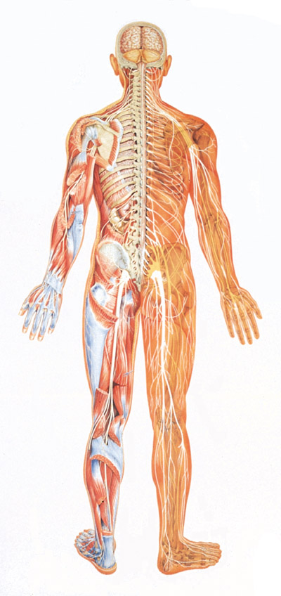

Slide 2
The nervous system is a network of specialized cells that communicate information about an animal's surroundings and itself.
It processes this information and causes reactions in other parts of the body. It is composed of neurons and other specialized cells called glia, that aid in the function of the neurons.

Slide 3

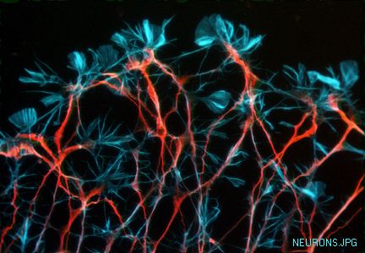

Slide 4
The body is made up of billions of cells. Cells of the nervous system, called neurons.
Neurons are electrically excitable cells in the nervous system that process and transmit information.

Slide 5
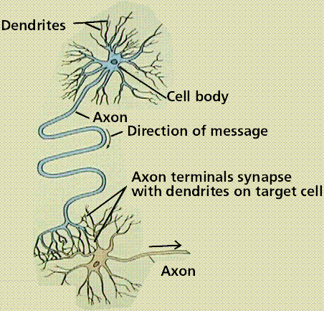
Structure Of Neuron

Slide 6
Neurons are consist of:
SOMA : The soma is the central part of the neuron.
DENDRITES: The dendrites of a neuron are cellular extensions with many branches, and metaphorically this overall shape and structure is referred to as a dendrites tree.
AXON: The axon is a finer, cable-like projection which can extend tens, hundreds, or even tens of thousands of times the diameter of the soma in length.
AXON TERMINAL: The axon terminal contains synapses, specialized structures where neurotransmitter chemicals are released in order to communicate with target neurons.

Slide 7
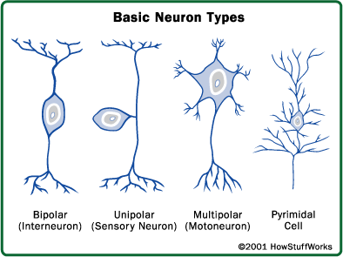
Types Of Neuron

Slide 8
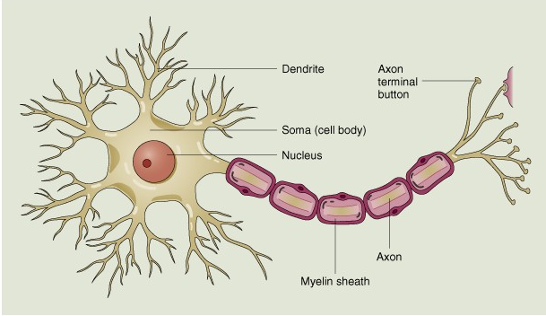
Nerve Cell

Slide 9

The junction between the axon terminals of a neuron and the receiving cell is called a synapse.

Slide 10
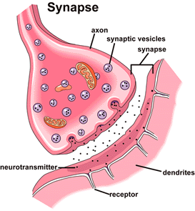

Slide 11

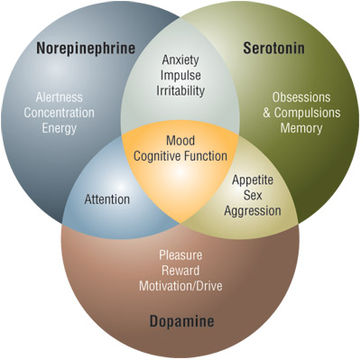

Slide 12
Neurotransmitters are chemicals that are used to relay, amplify and modulate signals between a neuron and another cell.

Slide 13
Dopamine – neurotransmitter of pleasure and pain, acts on the sympathetic nervous system producing effects such as increased heart rate and blood pressure, and is necessary for mental alertness, relaxation, pain relief and happiness. Parkinson's disease (PD) is believed to be caused by a deficiency of dopamine.
Dopamine Imbalances Cause problem in following areas:
Movement,memory,pleasurable reward behavior(food,sex) and cognition, attention inhibition of prolactin production,sleep,mood,learning

Slide 14
Excess and deficiency of this vital chemical is the cause of several disease conditions. Parkinson's disease and drug addiction are some of the examples of problems associated with abnormal dopamine levels.
Sleep Disorders In Animal Models Of Parkinson's Disease And Schizophrenia.

Slide 15
Serotonin - the master neurotransmitter. A molecule of happiness. It is found all over the body, with large concentration (95%) in digestive track and is necessary to balance the levels of the stress hormones. Serotonin is a precursor of melatonin, the hormone that is release at night, when you are asleep. Serotonin also regulates mood and appetite.

Slide 16
Norepinephrine – also known as a noradrenaline. A hormone – neurotransmitter release by adrenal glands in response to perceived threat. High levels of this hormone result in anxiety and insomnia. Norepinephrine also regulates metabolic processes (heart beat, blood pressure), calmness, relaxation and focus.

Slide 17
Epinephrine – also known as adrenalin. A "fight or flight" hormone - neurotransmitter secreted by the adrenal and released into the bloodstream in response to physical or mental stress, as from fear or injury. It initiates many bodily responses, including the stimulation of heart action and an increase in blood pressure, metabolic rate, and blood glucose concentration. Helps with focus, attention and productivity.

Slide 18
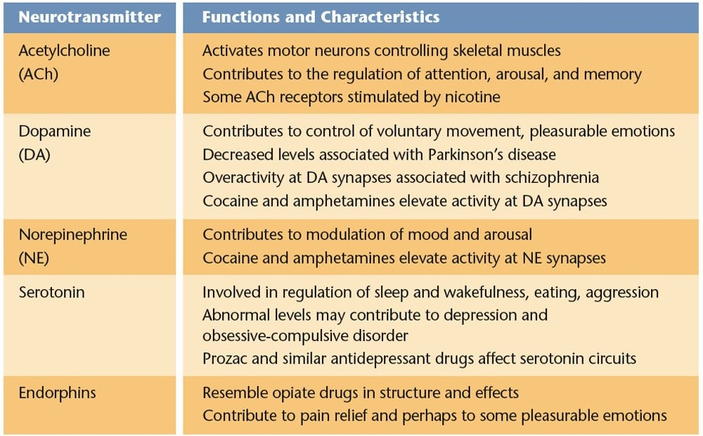
Summary

Slide 19
How Drugs and Chemicals Alter Neurotransmission
Drugs and other chemicals affect brain chemistry at synapses often by amplifying or blocking a NT activity
Some opiate drugs produces a temporary high amplifying normal sensations (heroin)
When the drug is withdrawn the brain may be deprived of any opiate causing intense discomfort

Slide 20
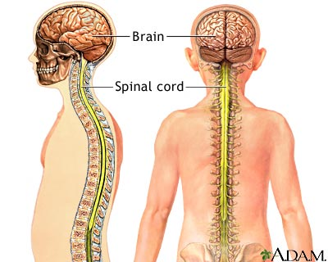
CENTRAL NERVOUS SYSTEM

Slide 21
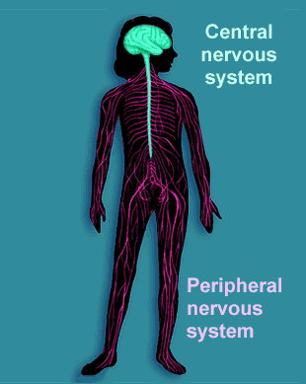

Slide 22
The central nervous system (CNS) is the part of the nervous system that functions to coordinate the activity of all parts of the bodies of multicellular organisms. In vertebrates, the central nervous system is enclosed in the meninges. It contains the majority of the nervous system and consists of the brain (in vertebrates which have them), and the spinal cord.

Slide 23
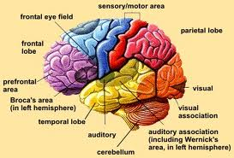
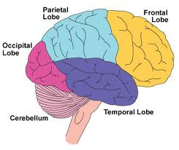
THE BRAIN

Slide 24
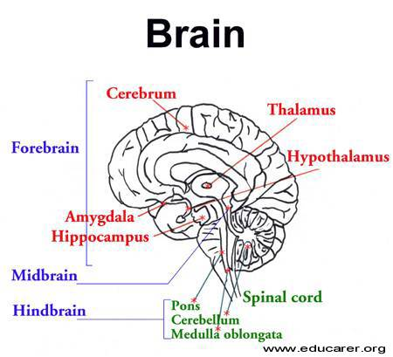

Slide 25
The brain is the part of the central nervous system located in the skull. It controls the mental processes and physical actions of a human being.

Slide 26
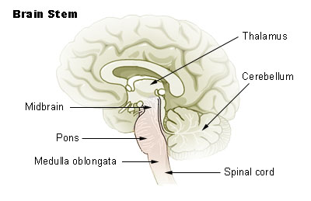
BRAIN STEM

Slide 27
Brain stem- most basic functions; respiration, swallowing, blood pressure. Lower part (medulla oblongata) is continuous with spinal cord.
Cerebellum-responsible for muscle coordination.Learning,memory.
Pons involved in sleep and arousal.
Thalamus relay information between lower and higher brain regions.
Reticular formation.attention,sleep
Basal ganglia:involved in movements.

Slide 28
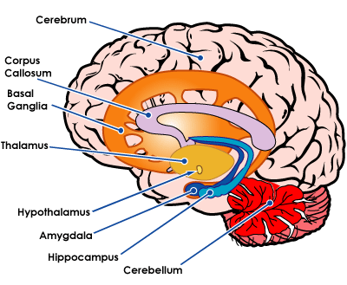

Slide 29
The limbic system is a set of brain structures including the hippocampus, amygdala, Hypothalamus and limbic cortex, which support a variety of functions including emotion, behavior, long term memory, and homeostasis in primary motives.
Amygdala: emotions, fear and anger
Hypothalamus: primary motive,Homeostasis,connection between pituitary gland and nervous system
Hippocampus: Memory

Slide 30
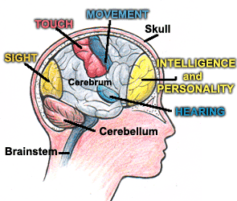

Slide 31
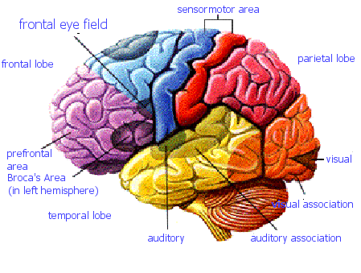
LOBES

Slide 32
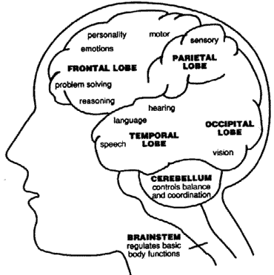

Slide 33
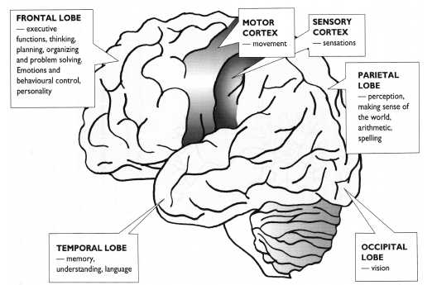

Slide 34
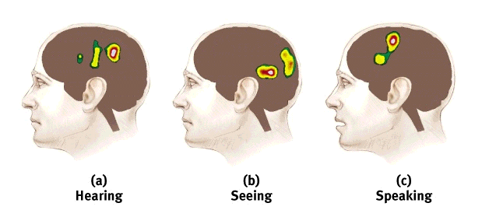
Specialization and Integration
Brain activity when hearing, seeing, and speaking words
Specialization and Integration

Slide 35
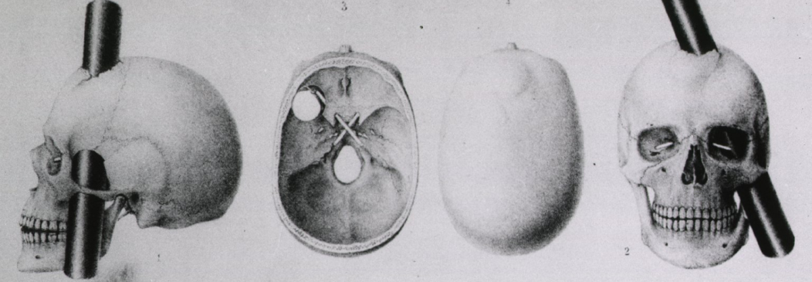
      Case: Phineas Gage was a railroad worker who suffered severe brain damage. As a result his limbic system (emotional center) was separated from his frontal lobe (planning center). Following the accident he was irritable and quick to be angry.
      Wilder Penfield’s sister had damage to her frontal lobe, and although she had perfect knowledge of cake recipes, she could not bake a cake.

Slide 36
FRONTAL LOBE
Located in front area or behind the forehead.
Concerned with reasoning, planning, parts of speech and movement (motor cortex), emotions, and problem-solving.
PARIETAL LOBE
Located between frontal and occipital lobe
Concerned with perception of stimuli related to touch, pressure, temperature and pain.

Slide 37
TEMPORAL LOBE
Located on sides of brain or just above the forhead.
Concerned with perception and recognition of auditory stimuli (hearing) and memory (hippocampus).
OCCIPITAL LOBE
Located at the back of the brain, behind the parietal lobe and temporal lobe.
Concerned with many aspects of vision.

Slide 38
Cerebral Specialization
Cerebral Hemispheres – two specialized halves connected by the corpus collosum
  Left hemisphere – verbal processing: language, speech, reading, writing
  Right hemisphere – nonverbal processing: spatial, musical, creativity, visual recognition

Slide 39
Hemispheric Dominance: Handedness
90% of humans are right-handed
The 10% of left-handers show less predictable patterns of hemispheric dominance
Personality differences

Slide 40
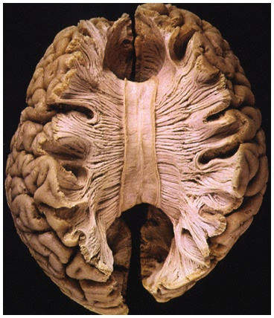
Split brain
a condition in which the two hemispheres of the brain are isolated by cutting the connecting fibers (mainly those of the corpus callosum) between them

Slide 41
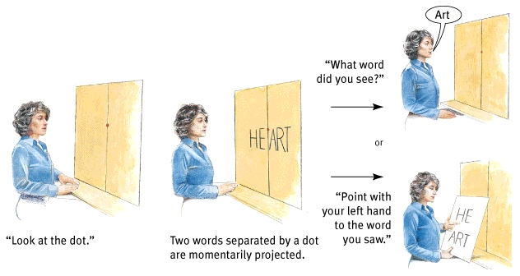
Split brain

Slide 42
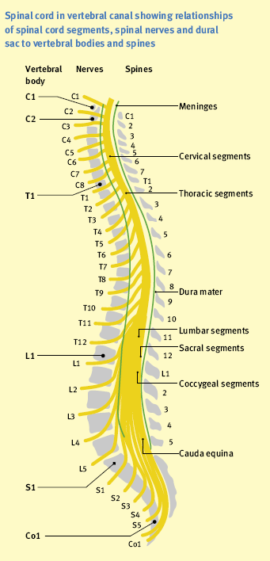
SPINAL CORD

Slide 43
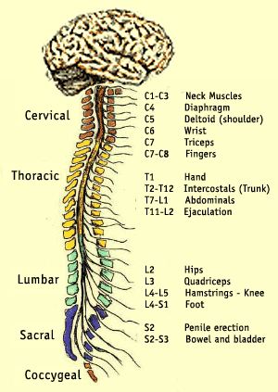

Slide 44
The spinal cord is the main pathway for information connecting the brain and peripheral nervous system with the body.16 to18 inches long,31 segments of nerves both sensory and motor. Reflexes.

Slide 45
Peripheral nervous system
Somatic system
  12 pairs cranial nerves
  31 pairs spinal nerves
Autonomic
  Sympathetic
    Fight or flight
  Parasympathetic

Slide 46
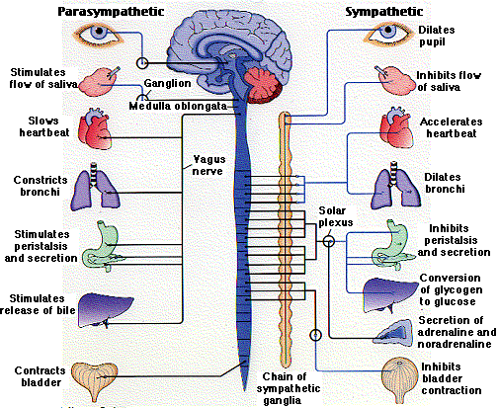
AUTONOMIC NERVOUS SYSTEM

Slide 47
The autonomic nervous system (ANS) (or visceral nervous system) is the part of the peripheral nervous system that acts as a control system, maintaining homeostasis in the body. These activities are generally performed without conscious control. The ANS affects heart rate, digestion, respiration rate, salivation, perspiration, diameter of the pupils, urination and sexual arousal. Whereas most of its actions are involuntary, such as breathing.
It can be divided by subsystems into the parasympathetic and sympathetic nervous system.

Slide 48
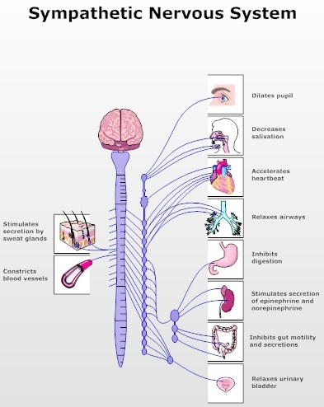

Slide 49
Sympathetic nervous system: A part of the nervous system that serves to accelerate the heart rate, constrict blood vessels, and raise blood pressure.

Slide 50
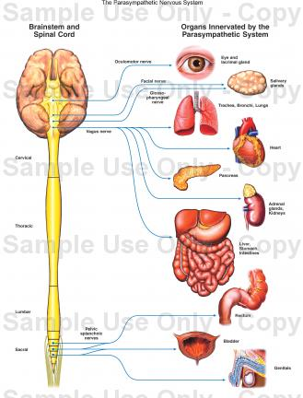
PARASYMPATHETIC NERVOUS
SYSTEM

Slide 51
The parasympathetic nervous system promotes digestion, synthesizes glycogen, and allows for normal function and behavior.

Slide 52
METHODS TO STUDY BRAIN
CAT
EEG
MRI
PET

Slide 53

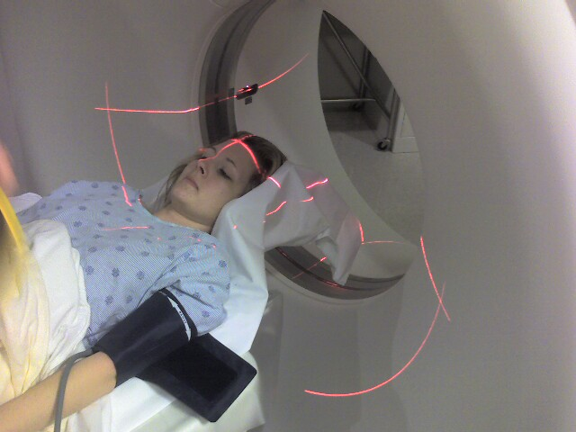

Slide 54

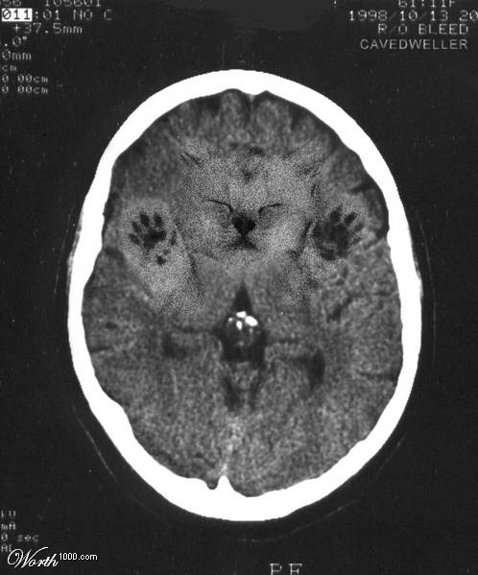

Slide 55
Computed Axial Tomography" is the process of using computers to generate a three-dimensional image from flat (i.e, two-dimensional) x-ray pictures, one slice at a time.

Slide 56

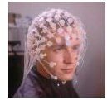

Slide 57
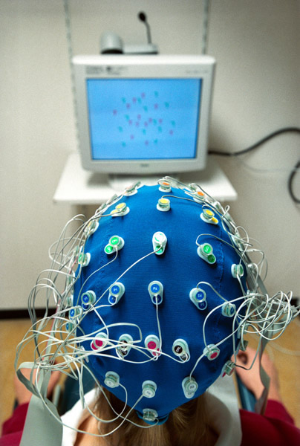

Slide 58
The EEG is used to show the electrical activity of the brain. Brain cells send messages to each other using small electrical impulses (or brainwaves). These can be measured to make sure everything is normal.

Slide 59

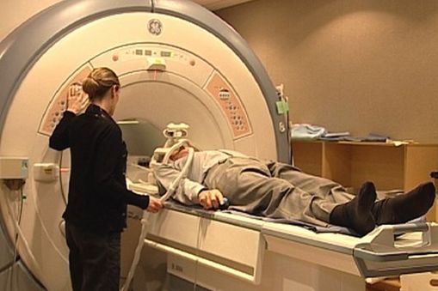

Slide 60

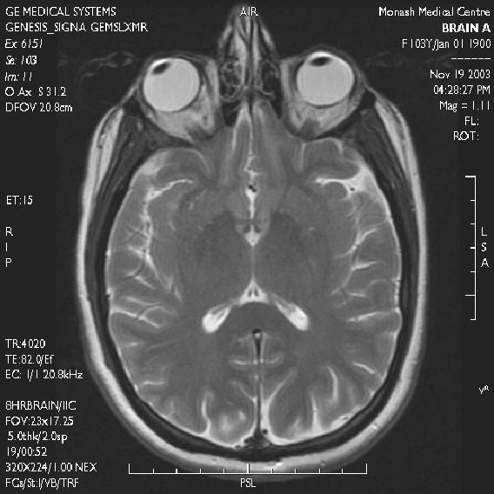

Slide 61
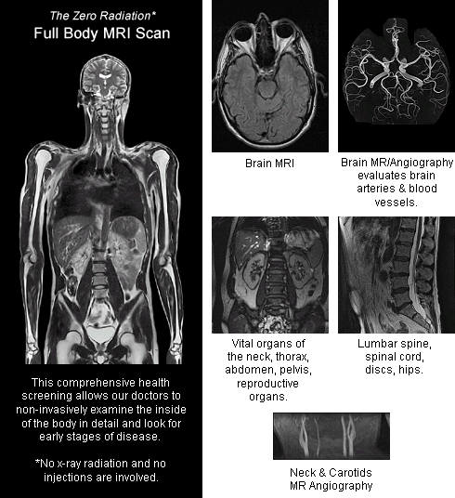

Slide 62
MRI stands for magnetic resonance imaging. An MRI scan uses a strong magnetic field and radio waves to create pictures on a computer of tissues, organs and other structures inside your body.

Slide 63
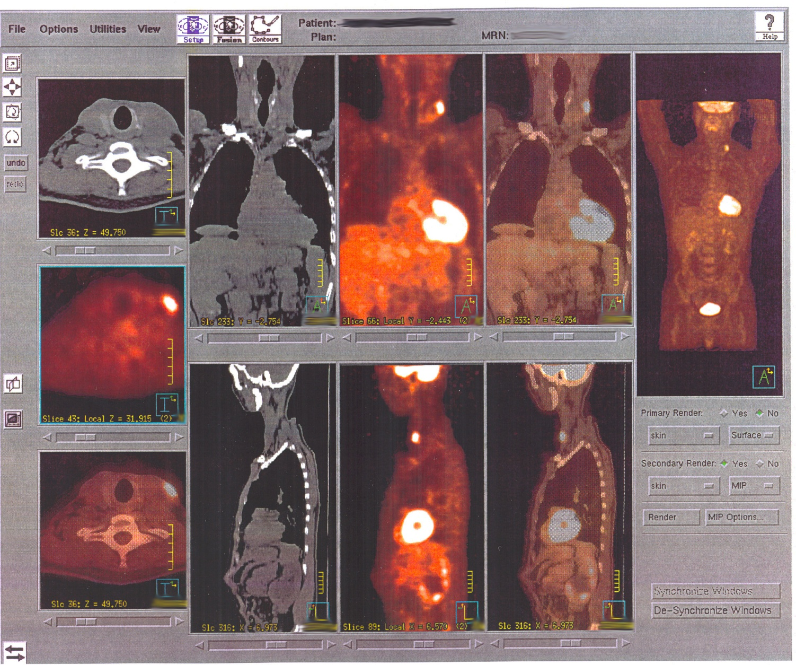
PET SCAN

Slide 64
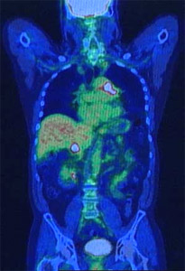

Slide 65
Positron Emission Tomography or PET is the most advanced medical diagnostic imaging technology available today for the early and accurate detection of cancer and its recurrence.

Slide 66
Endocrine system
The endocrine system is in charge of body processes that happen slowly, such as cell growth. Faster processes like breathing and body movement are controlled by the nervous system. But even though the nervous system and endocrine system are separate systems, they often work together to help the body function properly.

Slide 67
Endocrine Glands are glands of the endocrine system that secrete their products, hormones, directly into the blood rather than through a duct. The main endocrine glands include the pituitary gland, pancreas, ovaries, testes, thyroid gland, and adrenal glands.
Exocrine – release products (enzymes) into ducts
Ex) Sweat, tears, digestive juices
Endocrine – directly to bloodstream; NO DUCTS
Ex) Hormones

Slide 68
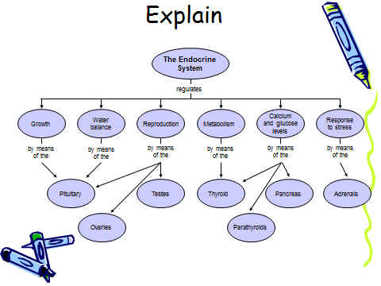

Slide 69
The pituitary gland hangs from the base of the brain and is enclosed by bone. It consists of a hormone-producing glandular portion (anterior pituitary) and a neural portion (posterior pituitary), which is an extension of the hypothalamus.
Controls Physical and skeletal system(dawarf -Giant)
The thyroid gland is located in the anterior throat. Thyroid malfunctioning can cause many physical and psychological problems. Effects body metabolisim,physical growth,memory,and mood, issues of weight gain and loss

Slide 70
The parathyroid glands, secrete parathyroid hormone (PTH), which causes an increase in blood calcium levels by targeting bone, the intestine, and the kidneys.
The paired adrenal glands sit atop the kidneys. Each adrenal gland has two functional portions, the cortex and the medulla.
Cortex
Produces more than 2 dozen steroid hormones
corticosteriods
Medulla
“fight or flight”
Epinephrine and norepinephrine
They release hormones adrenaline and cortisol. Active during emergencies, when stressors are always present and you constantly feel under attack, that fight-or-flight reaction stays turned on resulting in causing the following problems:
Anxiety
Depression

Slide 71
They release hormones adrenaline and cortisol. Active during emergencies, when stressors are always present and you constantly feel under attack, that fight-or-flight reaction stays turned on resulting in causing the following problems:
Anxiety
Depression
Digestive problems
Headaches
Heart disease

Slide 72
Sleep problems
Weight gain
Memory and concentration impairment resulting in causing the following problems:
reproduction and emotional behavior
The pancreas, located in the abdomen close to the stomach, is both an exocrine and an endocrine gland. The endocrine portion releases insulin and glucagon and smaller amounts of other hormones to the blood.

Slide 73
The pancreas, located in the abdomen close to the stomach, is both an exocrine and an endocrine gland. The endocrine portion releases insulin and glucagon and smaller amounts of other hormones to the blood.

Slide 74
The ovary is an ovum-producing reproductive organ, often found in pairs as part of the vertebrate female reproductive system.
Testis is the male reproductive organ.

